Slide 1
Trust, Science and Climate Change
Jonathan Boston
School of Government
Victoria University of Wellington
March 2025

Slide 2
Outline
The importance of public trust in science, scientists and scientific evidence
The links between trust in government and science
The current risks to science, globally and locally
Trust, science and climate change –evidence and trends
Trump 2.0
Implications and future prospects

Slide 3
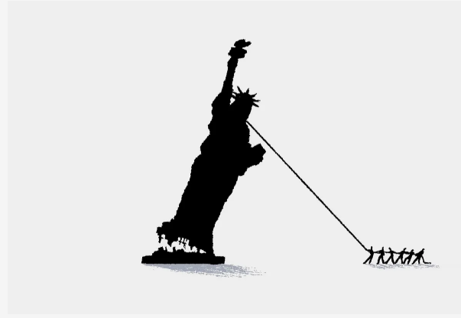

Slide 4
A Few References
There is a vast academic on the topic of trust, lots of survey data, much debate …
V. Cologna, et al., Trust in scientists and their role in society across 68 countries, Nature Human Behaviour, 2025
OECD, Survey on Drivers of Trust in Public Institutions – 2024 Results: Building Trust in a Complex Policy Environment
The OECD Reinforcing Democracy Initiative: Monitoring Report – Assessing Progress and Charting the Way Forward
Kate Prickett and Simon Chapple, ‘Trust in Government and Covid-19 Vaccine Hesitancy’, Policy Quarterly, 17, 3, 2021
Kate Prickett and Simon Chapple, Who do we trust in New Zealand: 2016-2019 https://www.wgtn.ac.nz/__data/assets/pdf_file/0011/1762562/trust-publication-2019.pdf
Thomas Simpson, Trust: A Philosophical Study, OUP, 2013
https://acumennz.com/acumen-edelman-trust-barometer/acumen-edelman-trust-barometer-2023/

Slide 5
Why trust in science, scientists and scientific evidence matters
Science involves independent, rigorous investigation (via multiple methodologies), subject to critical peer review; falsifiability is an important (but not the only) test of whether a hypothesis, theory or conjecture is scientific or not; uncertainty is an inherent feature
Scientific research and evidence provide a reliable basis for distinguishing truth from falsehood and enabling policy decisions based on robust evidence rather than prejudice, unfounded beliefs, misinformation, conspiracy theories, etc.
Public trust and confidence in science is thus vital for good governance, prudent decision-making and desirable policy outcomes – e.g. public health, work safety, a more sustainable environment, technological innovation, higher productivity, etc.
Public distrust of science contributes to:
political polarization, disagreement, policy short-termism, policy failures
vaccine hesitancy and/or resistance to health guidelines, putting communities at risk
opposition to policies designed to protect the environment

Slide 6
The links between trust in government and science
People who trust the government to do the right thing are more likely to accept the scientific findings that the government endorses
Where trust in government is low, people are more likely to question the science it promotes
Public trust in science can influence how those policies are received. Those who believe in the credibility of science are more likely to comply
The politicization of science (e.g. under Trump 2.0), is likely to erode trust in both government and science

Slide 7
The links between trust in government and science
OECD survey of public in OECD countries, 2023:
39%: trust their national government
37%: are confident that their government balances the interests of current and future generations
41%: believe their government uses the best available evidence when taking a decision
OECD: https://www.oecd.org/en/publications/oecd-survey-on-drivers-of-trust-in-public-institutions-2024-results_9a20554b-en.html

Slide 8
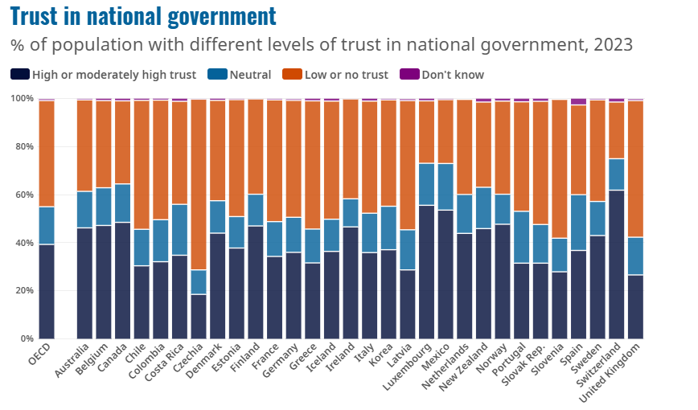
OECD: https://www.oecd.org/en/publications/oecd-survey-on-drivers-of-trust-in-public-institutions-2024-results_9a20554b-en.html

Slide 9
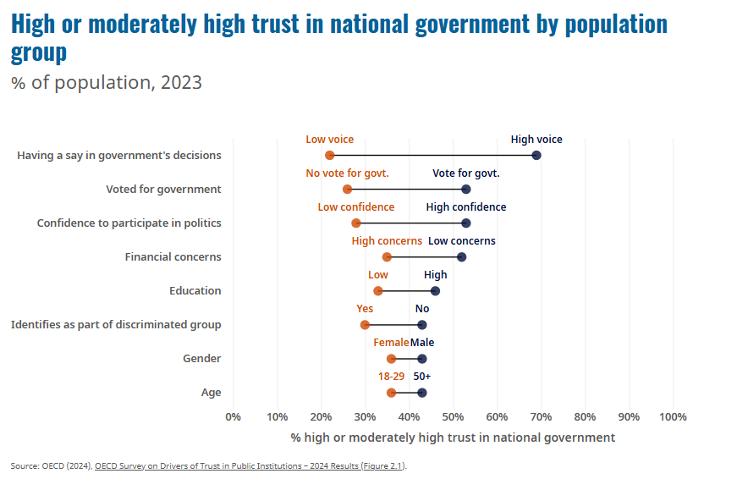

Slide 10
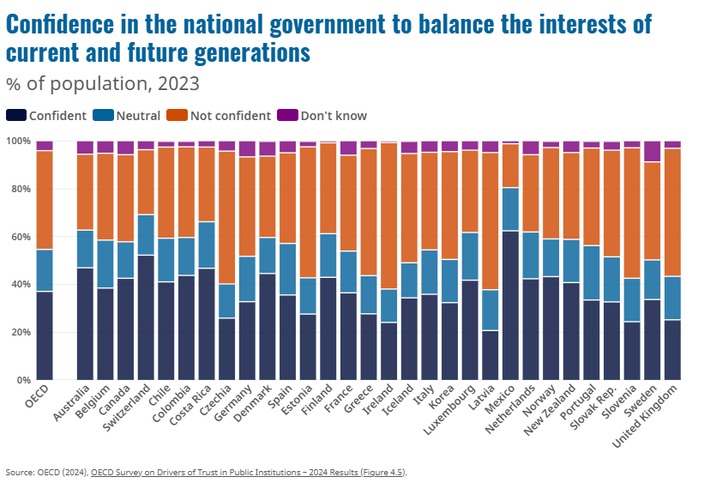

Slide 11
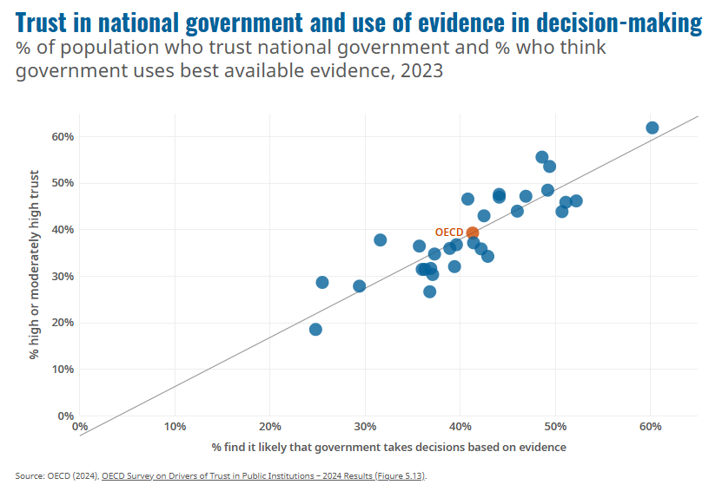

Slide 12
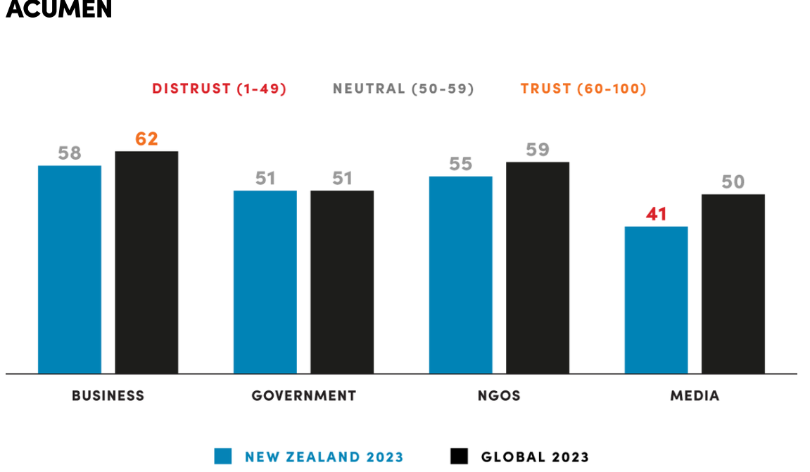
Some NZ evidence regarding levels of public trust is concerning
https://acumennz.com/acumen-edelman-trust-barometer/acumen-edelman-trust-barometer-2023/

Slide 13
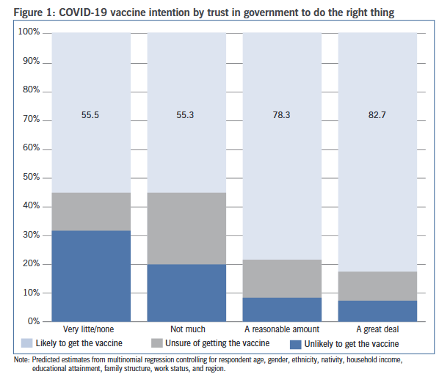
Kate Prickett and Simon Chapple, ‘Trust in Government and Covid-19 Vaccine Hesitancy’, Policy Quarterly, 17, 3, 2021, p.70 (NZ)

Slide 14
The current risks to science and trust in science – globally and locally
Powerful commercial interests
Authoritarian regimes
Populist movements – nationalist, illiberal, fundamentalist, etc.
Rapid spread of disinformation and misinformation via social media platforms
Reduced public spending on R&D and mass sacking of scientists (as in US)
Political interference in research funding decisions
Constraints on freedom of expression bvy
Withdrawal of support for international scientific bodies

Slide 15
Trust, Science and Climate Change
Tackling major global issues such as climate change requires robust scientific evidence and the willingness of policy-makers to apply this evidence prudently
Globally, there has been a large investment in climate science, across multiple disciplines, since the 1980s, including the establishment of the Intergovernmental Panel on Climate Change (IPCC) to assess periodically the latest scientific evidence; six comprehensive reviews thus far and various special reports
But three key problems:
much evidence is inconvenient to powerful vested interests; they have invested heavily in undermining public trust and confidence in the ‘mainstream’ evidence, sowing doubt, contributing to misinformation and disinformation, etc.
deep uncertainty + ongoing scientific debates about vital issues (e.g. climate sensitivity, the micro-physics of clouds, ice-sheet stability, tipping points, etc.)
policy-makers face many stark intertemporal and distributional trade-offs, both regarding mitigation (i.e. GHG emissions reductions) and adaptation

Slide 16
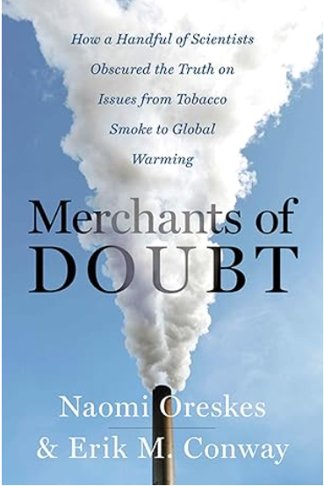

Slide 17
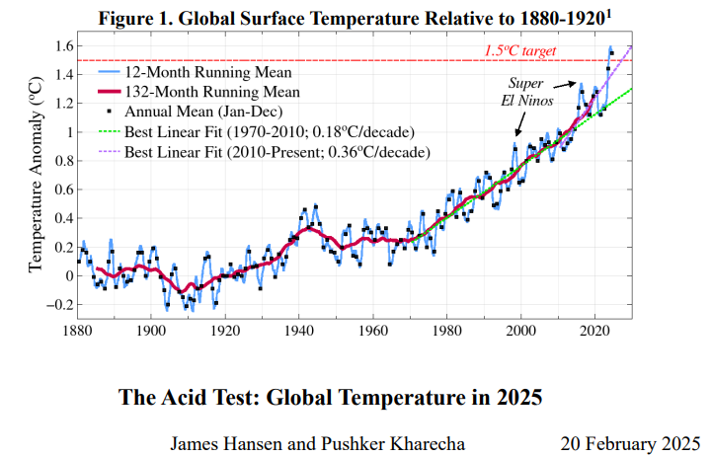

Slide 18
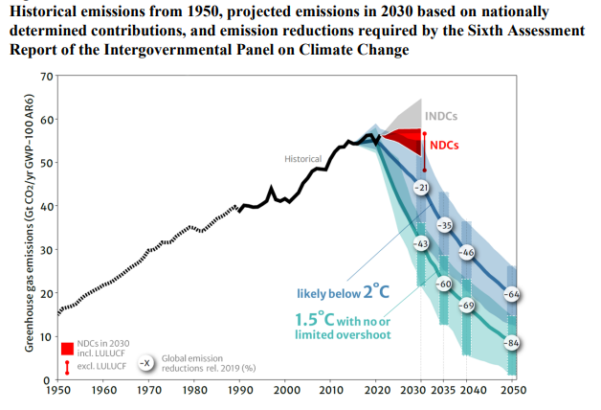
UNFCCC
FCCC/SB/2023/9
Synthesis report by the co-facilitators on the technical dialogue, p.17
8 September 2023

Slide 19
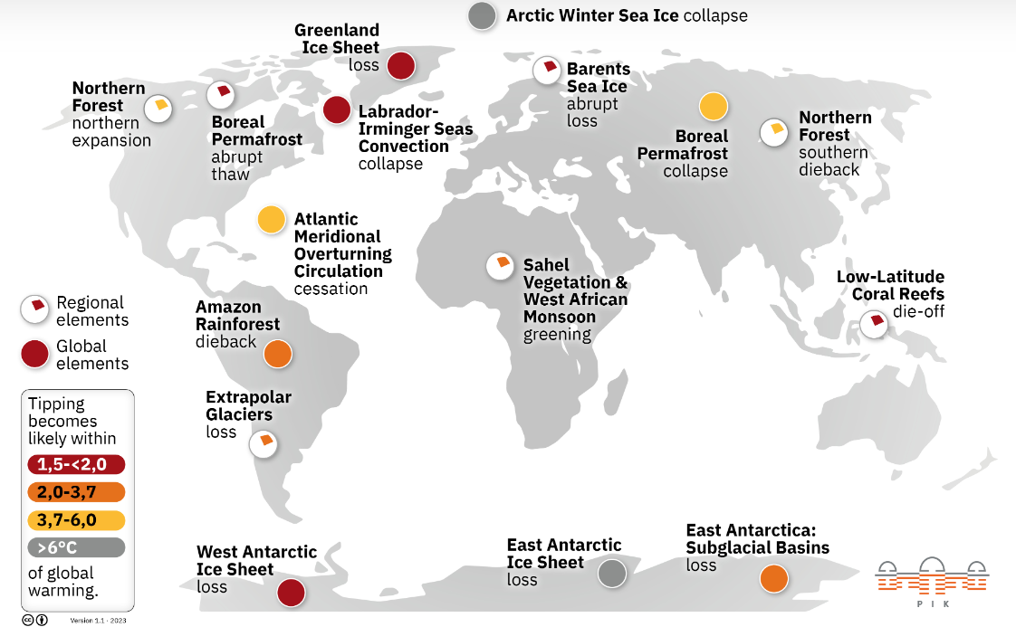
Tipping elements and tipping points

Slide 20
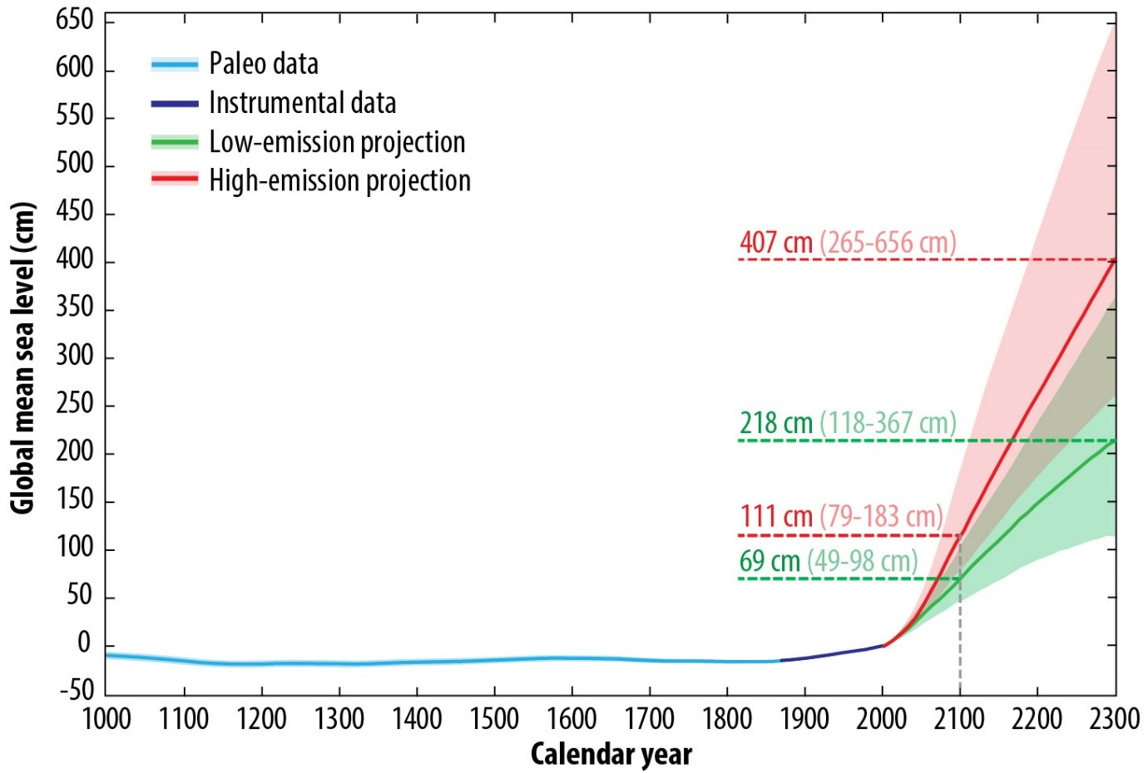
Keven Roy, Nicole S. Khan, Timothy A. Shaw, Robert E. Kopp and Benjamin P. Horton, ‘Sea level under climate change: Understanding the links between the past and the future’, Climanosco Research Articles 2, 14 Jan 2021, https://doi.org/10.37207/CRA.2.6

Slide 21
Public trust in science, including climate science
First, the good news:
According to a global survey of about 72,000 people across 68 countries during 2022-23 (including , 2000+ in NZ) published in Nature in January 2025, most people hold science and scientists in high regard, and they value scientific expertise and its role in addressing major societal issues
New Zealanders are among the most trusting of scientists – ranking 9th
Overall, globally, the following groups trusted science most: women, the elderly, the educated, higher-income earners, city dwellers, politically liberal, and religious believers – but there were country variations
Unsurprisingly, those with more conservative political views in the US are less trusting of science (e.g. long-standing rejection of evolution, etc.)
Separate studies indicate that those with a higher trust in science tend to take more measures to mitigate climate change
See: https://www.nature.com/articles/s41597-024-04100-7?fromPaywallRec=false

Slide 22
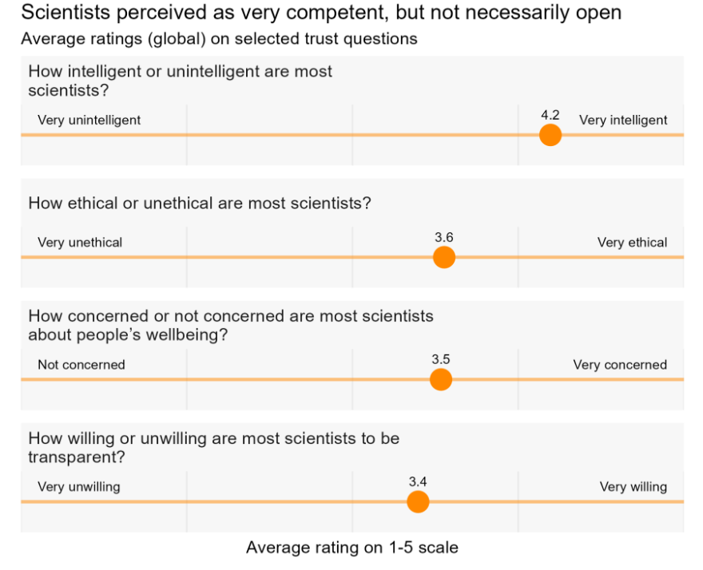
Source: https://www.phcc.org.nz/briefing/global-survey-shows-new-zealanders-value-science-highly-prioritise-public-health

Slide 23
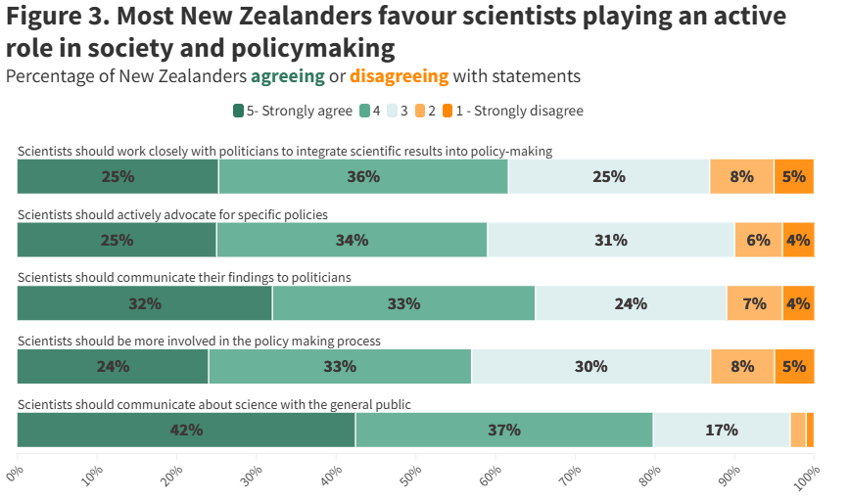
Source: https://www.phcc.org.nz/briefing/global-survey-shows-new-zealanders-value-science-highly-prioritise-public-health

Slide 24
Public trust in science, including climate science
Second, the bad news:
Voters keep electing people sceptical of mainstream climate science to influential roles and challenging efforts by governments to reduce GHG emissions and implement effective adaptation measures
Recent measures by the Trump Administration 2.0, drawing on Project 2025, include:
Abandoning the Paris Climate Change Agreement
Restricting international collaboration by scientists (e.g. IPCC)
Freezing clean energy funds
Removing information about climate change from federal websites and other forms of censorship
Reducing research funding for climate change
Sacking many scientists
Leadership appointments
many people who have expressed scepticism about climate change have been appointed to key roles in the Administration: e.g. Lee Zeldin, who has voiced doubts about climate change, was confirmed as the Administrator of the Environmental Protection Agency (EPA) on 29 January 2025

Slide 25
Implications and future prospects
We live in disturbing, if not fearful times …
The combination of Trump 2.0, autocracies, right-wing populism, political polarization, commercial vested interests, etc. seem destined to reduce public trust and confidence in democratic governance and science over the medium-term
Progress to address many major global and local policy issues, including climate change, is likely to be more difficult over the medium-term, especially where trust in scientific evidence is essential for prudent policy-making and effective implementation

Slide 26
Implications and future prospects
We live in disturbing, if not fearful times …
It will be difficult to counter any decline in trust given the influence of the negative forces that are at work globally
Options include:
Concerted regulation of major social media platforms like ‘X’ and Facebook, but this runs the risk of restricting freedom of expression
Publicly-funded fact checking and science communication
Reform of electoral/campaign finance – more transparency and donation limits
Better civics education in schools
Establish a Parliamentary Office for Science and Technology, etc.

